Slide 1
Lin-GO!
Maggie Foster | Banibe Ebegbodi | Kati Putman | Wesley Morgan | Raj Sureka

Slide 2
CHECKPOINT OVERVIEW
What is Lin-GO!?
3
PR & FAQ
5
Exploratory Research
7
Alpha
9

Slide 3
What is Vision Pro and Lin-GO?

Slide 4
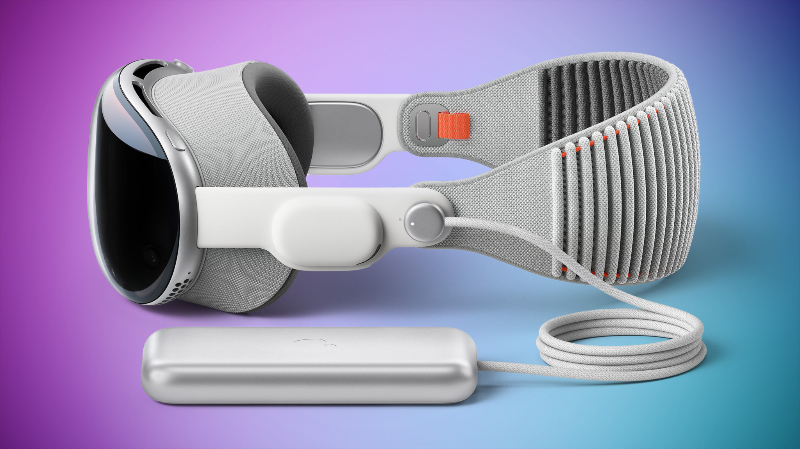


Slide 5
PR & FAQ

Slide 6


Slide 7
Exploratory Research

Slide 8
Learning vs. memorizing
People learn better when the experience is immersive.
Immersive experiences
Using AI to simulate a realistic conversation aids users in learning a language rather than memorizing cookie cutter responses.
Notes:
Business Insider and Scientific American - better learn language and vocabulary
Duolingo - prescripted conversation starters

Slide 9
Alpha

Slide 10
Thank You!
Ready, Set, Lin-GO!

Slide 11
With a fully functioning Lin-GO! app, both travelers and language learners will be able to combat language barriers more effectively than when using alternative language learning apps. The app is beneficial to travelers who will be able to efficiently navigate, communicate in, and freely explore countries, uninhibited by a language barrier. Additionally, users who are solely interested in learning a foreign language will be able to practice in immersive, real-world scenarios from anywhere.

